Slide 1
National Survey of Heritage Funding and Incentive Programs: Opportunities for Oregon For Oregon Heritage
April 2017

Slide 2
Overview of Profiled Projects
1. State Income Tax Credits
2. State Business Income Tax Credits
3. State Special Taxing Districts
4. Property Tax Freeze & Local Property Tax Surcharge
5. Gaming Revenues
6. Direct Funding from State Governments
7. Direct Funding from Statewide Preservation Organizations
8. Loan Funds for Preservation Activities
Matching Funds for Endowments for History Organizations
Other Incentives or Funding for Heritage Projects
BASELINE http://www.oregon.gov/oprd/HCD/FINASST/Pages/index.aspx
22 PROFILES
Notes:
Our work began in February 2017 when we undertook basic research across the country looking for state, county, and local funding programs for historic preservation and heritage organizations. We amassed a spread sheet of 150 different programs. They varied widely and fell into these ten categories.
That spread sheet includes the name of the program, some basic information about what the program is, the agency/organization that manages it, and a website for more information. It is available on the OPRD web site at http://www.oregon.gov/oprd/HCD/FINASST/Pages/index.aspx
Kuri Gill worked with me to identify which of these programs were the best of their type, the most typical, or offered an out of the ordinary funding mechanism that ought to be better known. We wanted to develop short, one page profiles about the more interesting programs and produce this publication that is in your hands.
We wrote all 22 profiles in four weeks.
http://www.oregon.gov/oprd/HCD/FINASST/Pages/index.aspx

Slide 3
1. State Income Tax Credits
Oklahoma State Income Tax Credit for Commercial Properties
Virginia State Income Tax Credit for Residential Properties
Notes:
We wanted to start with state income tax credits that mirror the 20% Federal Historic Preservation Tax Credit for Rehabilitation.

Slide 4
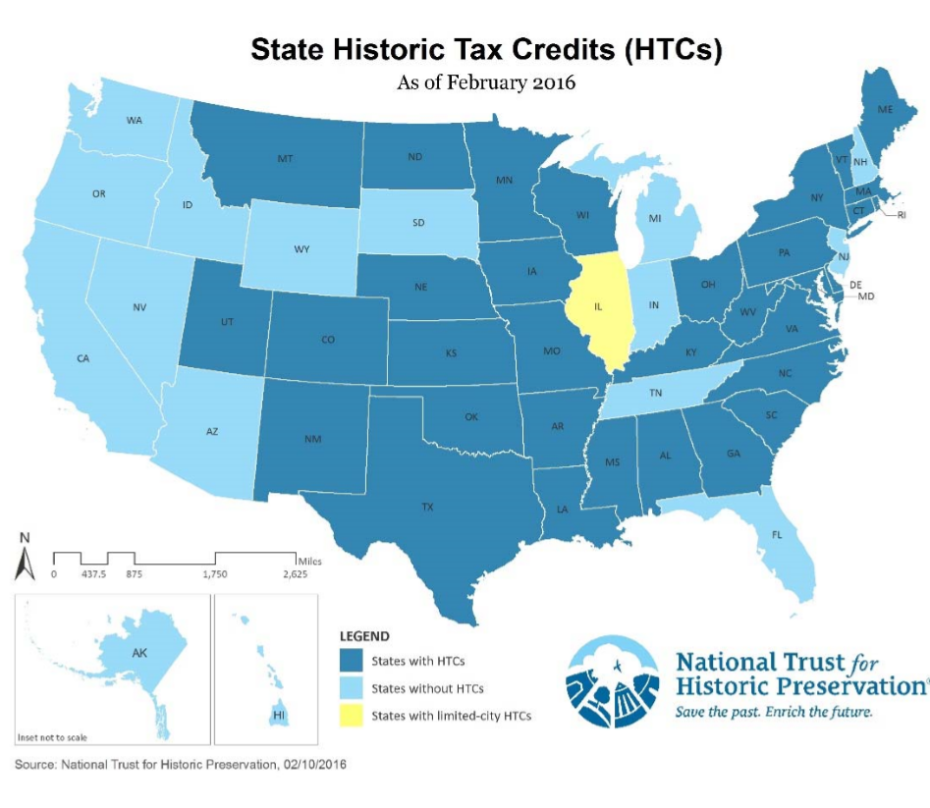
State Tax Credits in General
34 states have State Income Tax Credits for Rehabilitation for commercial properties
Oregon is one of 16 states that does not yet have a State Income Tax Incentive Program
23 states now have State Income Tax Credit Programs for Residential Properties, which are highly popular as there is no parallel federal tax credit for homeowners.
Notes:
There are 34 states that have enacted a state tax credit to mirror the Federal 20% Historic Preservation Tax Credit program for income producing properties.
Oregon is one of 16 states that does not yet have a State Income Tax Incentive Program.
23 states now have State Income Tax Credit Programs for Residential Properties. These programs are highly popular as there is no parallel federal tax credit for homeowners.
If Oregon was to enact legislation, we suggest that it follow the Oklahoma model.

Slide 5
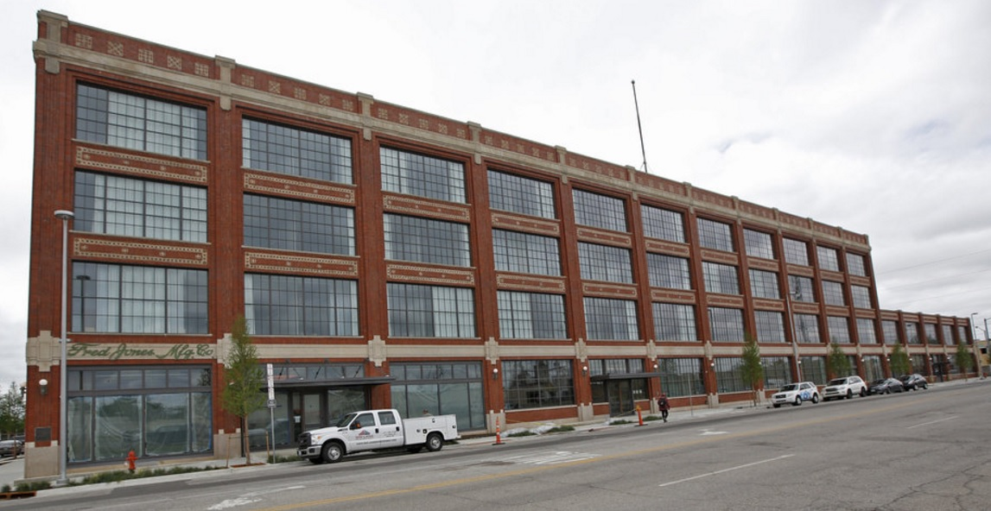
Oklahoma 20% State Historic Preservation Tax Credits ─── Commercial
The 21c Museum Hotel, Oklahoma City, rehabilitated using Oklahoma’s 20% state historic preservation tax credit. Source: NewsOk.com. http://newsok.com/article/5499488
Notes:
• In 1992, the Oklahoma Legislature passed legislation to provide state rehabilitation tax credits to historic hotels and newspaper plants
• Incentive was expanded to allow other income-producing historic buildings to take advantage of a 20% state income tax credit
• This state tax credit program is considered one of the three best in the US
• Key factors of success:
• NO aggregate annual caps; NO individual project caps
• Free transferable for 5 years to a third party
• Ability to “carry forward” the credits to other tax years
• PlaceEconomics—Some of you know Donovan Rypkema found that every $1 awarded in tax credits catalyzed $11.70 in economic activity, and the Oklahoma treasury received more than 50% of the money back before the credit was even awarded.
• Oklahoma’s state tax credit program is also used frequently for small scale rehabilitation projects as would be found in local Main Street programs.

Slide 6
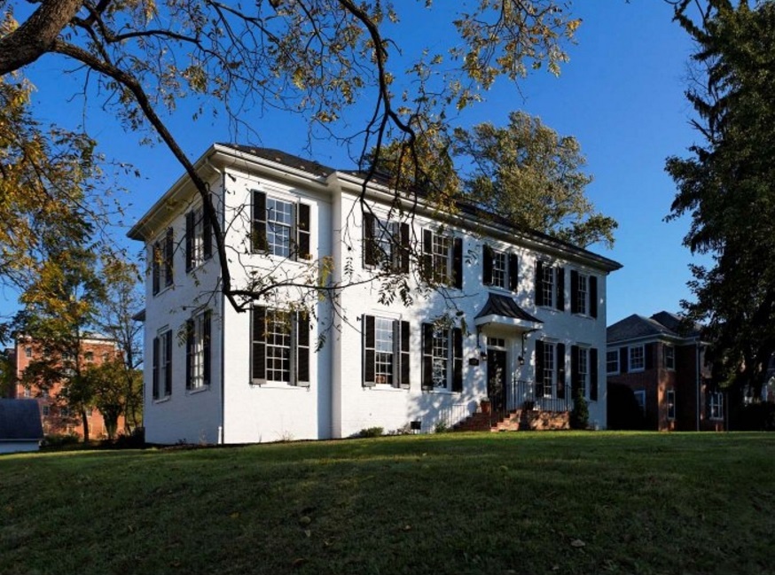
Virginia State Historic Preservation Tax Credits ─── Residential
Residential property in Staunton, Virginia, rehabilitated using Virginia state historic preservation tax credits. Source: Miller & Associates, http://www.robinmillerassociates.com/historic-tax-credit
Notes:
23 states have developed tax credit programs for homeowners.
• Virginia offers a state tax credit for residential property rehabilitation
• No federal parallel. There is no federal incentive for homeowners.
• This program provides a 25% tax credit for owner-occupied residential properties
• Qualification:
• Reconstruction and/or other improvements must amount to at least 25% of the assessed value of the owner-occupied building, and follow the Secretary of the interior’s standards for Rehabilitation

Slide 7
2. State and Local Business Tax Credits
Missouri Neighborhood Assistance Program
Washington State Main Street Tax Credit Program
New Jersey Historic Trust
Philadelphia PA Community Development Corporation Tax Credit Program
Notes:
Three of the state business tax credit programs in Washington, Missouri, and Philadelphia offer unrestricted operating support for downtown organizations to promote their Main Street efforts.
• Private contribution to the local Main Street Organizations will receive a tax credit worth up to 75% of the contribution
• Business statewide contr bute to the Preservation’s Main Street Trust Fund will receive a tax credit worth up to 50% of donation
• Donation of both up to $250,000, additionally federal income tax deduction may be eligible if the downtown organization is a 501(c)(3).
• Cannot carry forward the credit, nor can the credit be refunded.
Missing word?

Slide 8
Washington State Main Street Tax Credit Program
Local Main Street programs in Washington can participate in a tax credit program to fund their operations. Photo courtesy Washington Main Street Tax Credit Program. http://www.dahp.wa.gov/sites/default/files/MSTCI%20Brochure.pdf
Notes:
• Private contribution to the local Main Street Organizations will receive a tax credit worth up to 75% of the contribution
• Business statewide contr bute to the Preservation’s Main Street Trust Fund will receive a tax credit worth up to 50% of donation
• Donation of both up to $250,000, additionally federal income tax deduction may be eligible if the downtown organization is a 501(c)(3).
• Cannot carry forward the credit, nor can the credit be refunded.

Slide 9
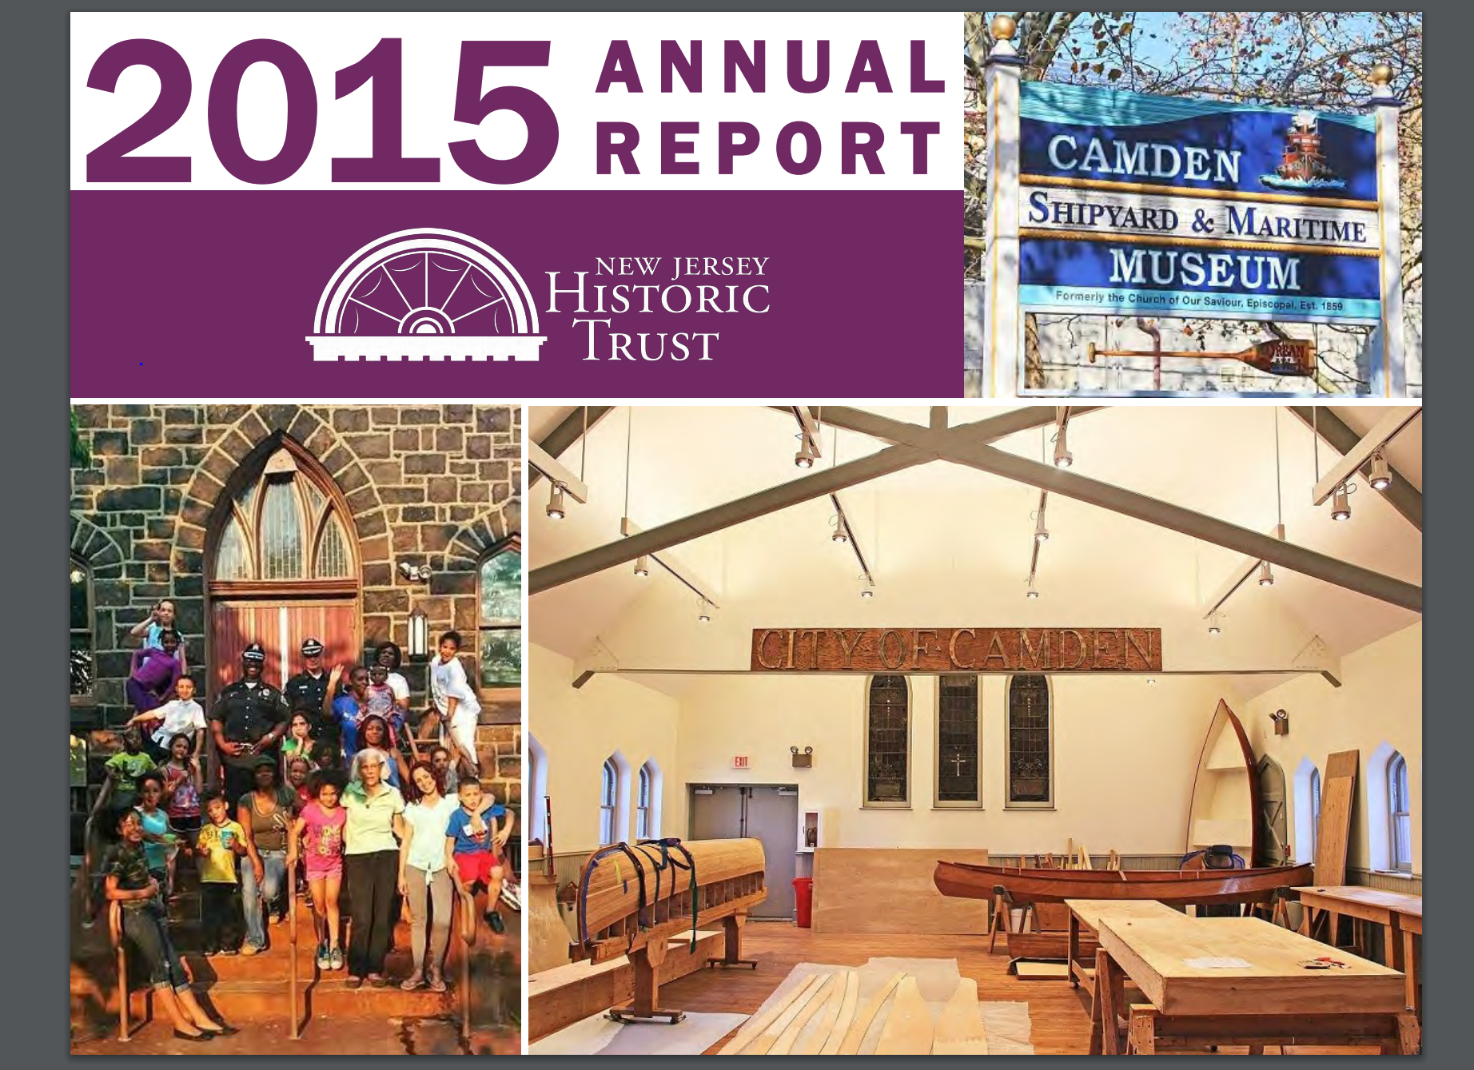
New Jersey Historic Trust State Corporate Income Tax Funds Preservation Grants
Annual report 2015 of the New Jersey Historic Trust.
Source: http://www.njht.org/dca/njht/resources/annual/2015_Annual_Report_forweb.pdf
Notes:
The New Jersey State Constitution was changed to permit a small portion of the NJ corporate business tax to be allocated yearly to the New Jersey Historic Trust.
The New Jersey Historic Trust uses their four percent (4%) of the allocation each year for planning and capital construction projects for historic properties, cemeteries, and house museums, including churches.
• The switch from using occasional bond funds to using the state corporate income tax was viewed as providing a stable and predictable revenue source of grants
• The historic preservation grants are 4% of the revenue pool, and are likely to generate between $3 and $4 million annually.
• This is a sharp cut to the historic preservation grant pool from previous bond grant rounds, where between $5 to $10 million were allocated to historic preservation grants.

Slide 10
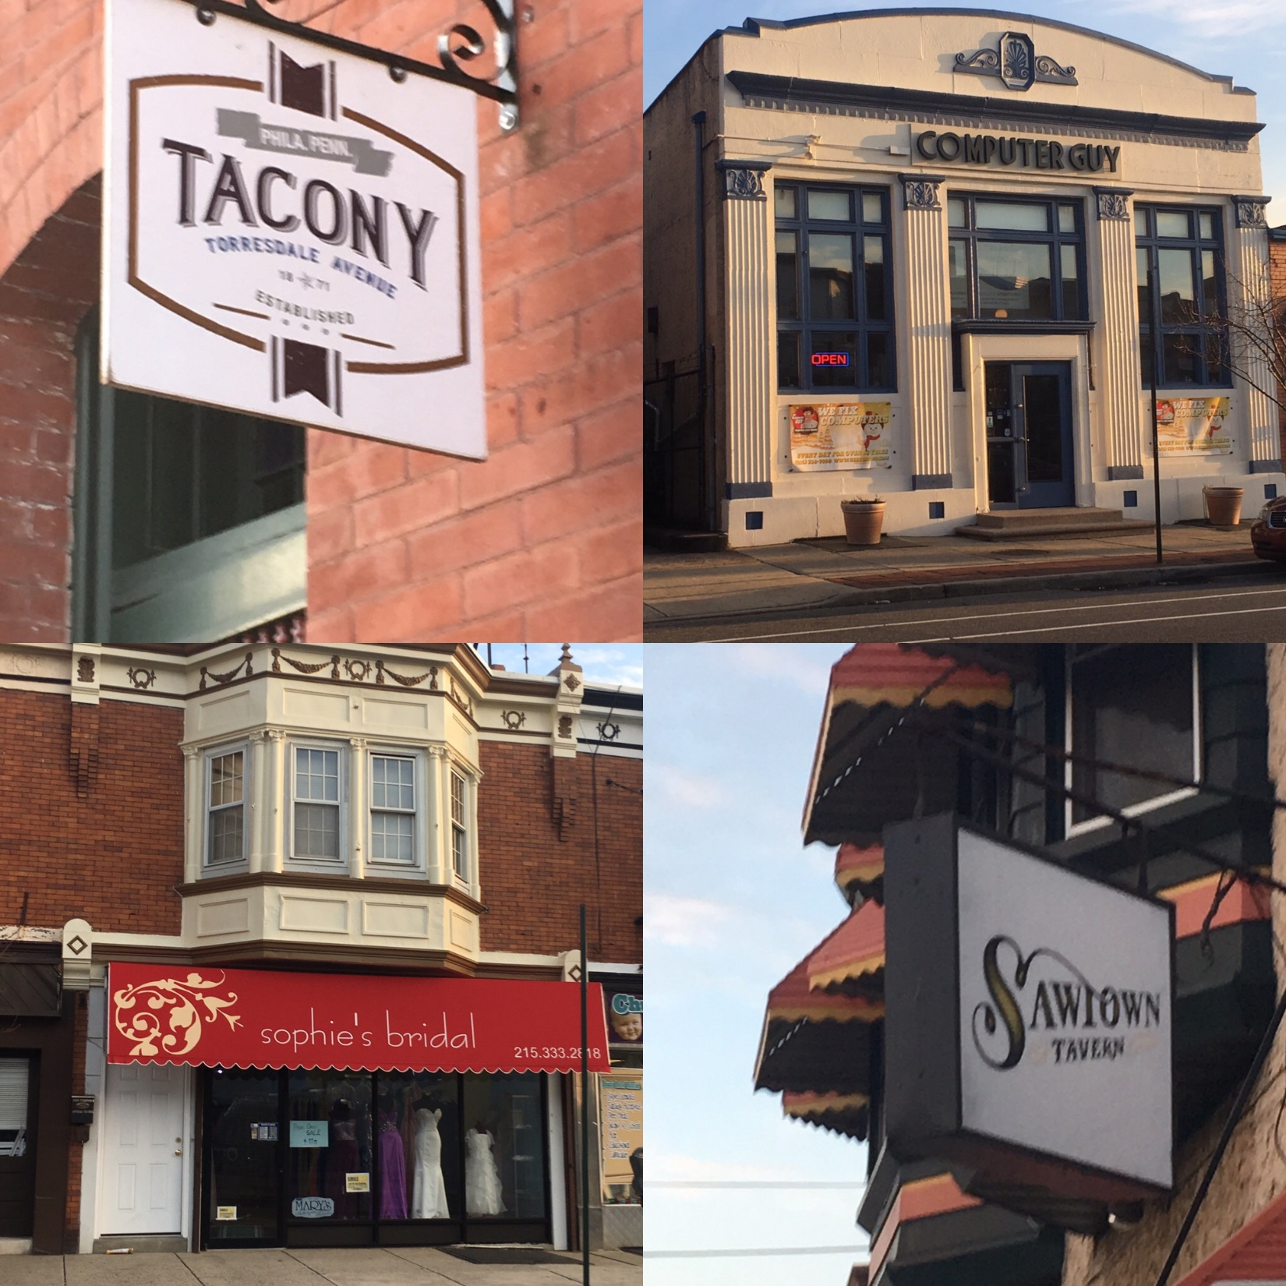
Philadelphia, PA Community Development Corporation Tax Credit Program
.
Photos by Donna Ann Harris.
Notes:
Philadelphia, PA’s Community Development Corporation Tax Credit Program
…offers $100,000 in business tax credits yearly through a ten-year partnership with 42 Community Development Corporations undertaking economic development programs throughout the city.
The Tacony Community Development Corporation in Philadelphia uses the CDC Tax Credit to pay staff salaries and to match a portion of the merchant’s contribution to the city’s storefront grant program. Some completed storefront programs are shown here
• In return for contributing $100,000 per year to a CDC for ten years (with yearly renewable ) a business or two businesses partnering for the total grant amount of $100,000 receive a credit of $100,000 per year against their Philadelphia Business Income and Receipts Tax obligation
Missing word?

Slide 11
3. State Special Taxing Districts
Oregon Special District
Notes:
The Oregon law that allows for the creation of “heritage districts” …permits local historical societies and museums in one or multiple counties to band together to create a heritage district and ask voters to fund it by an annual tax for all residents of the district.

Slide 12
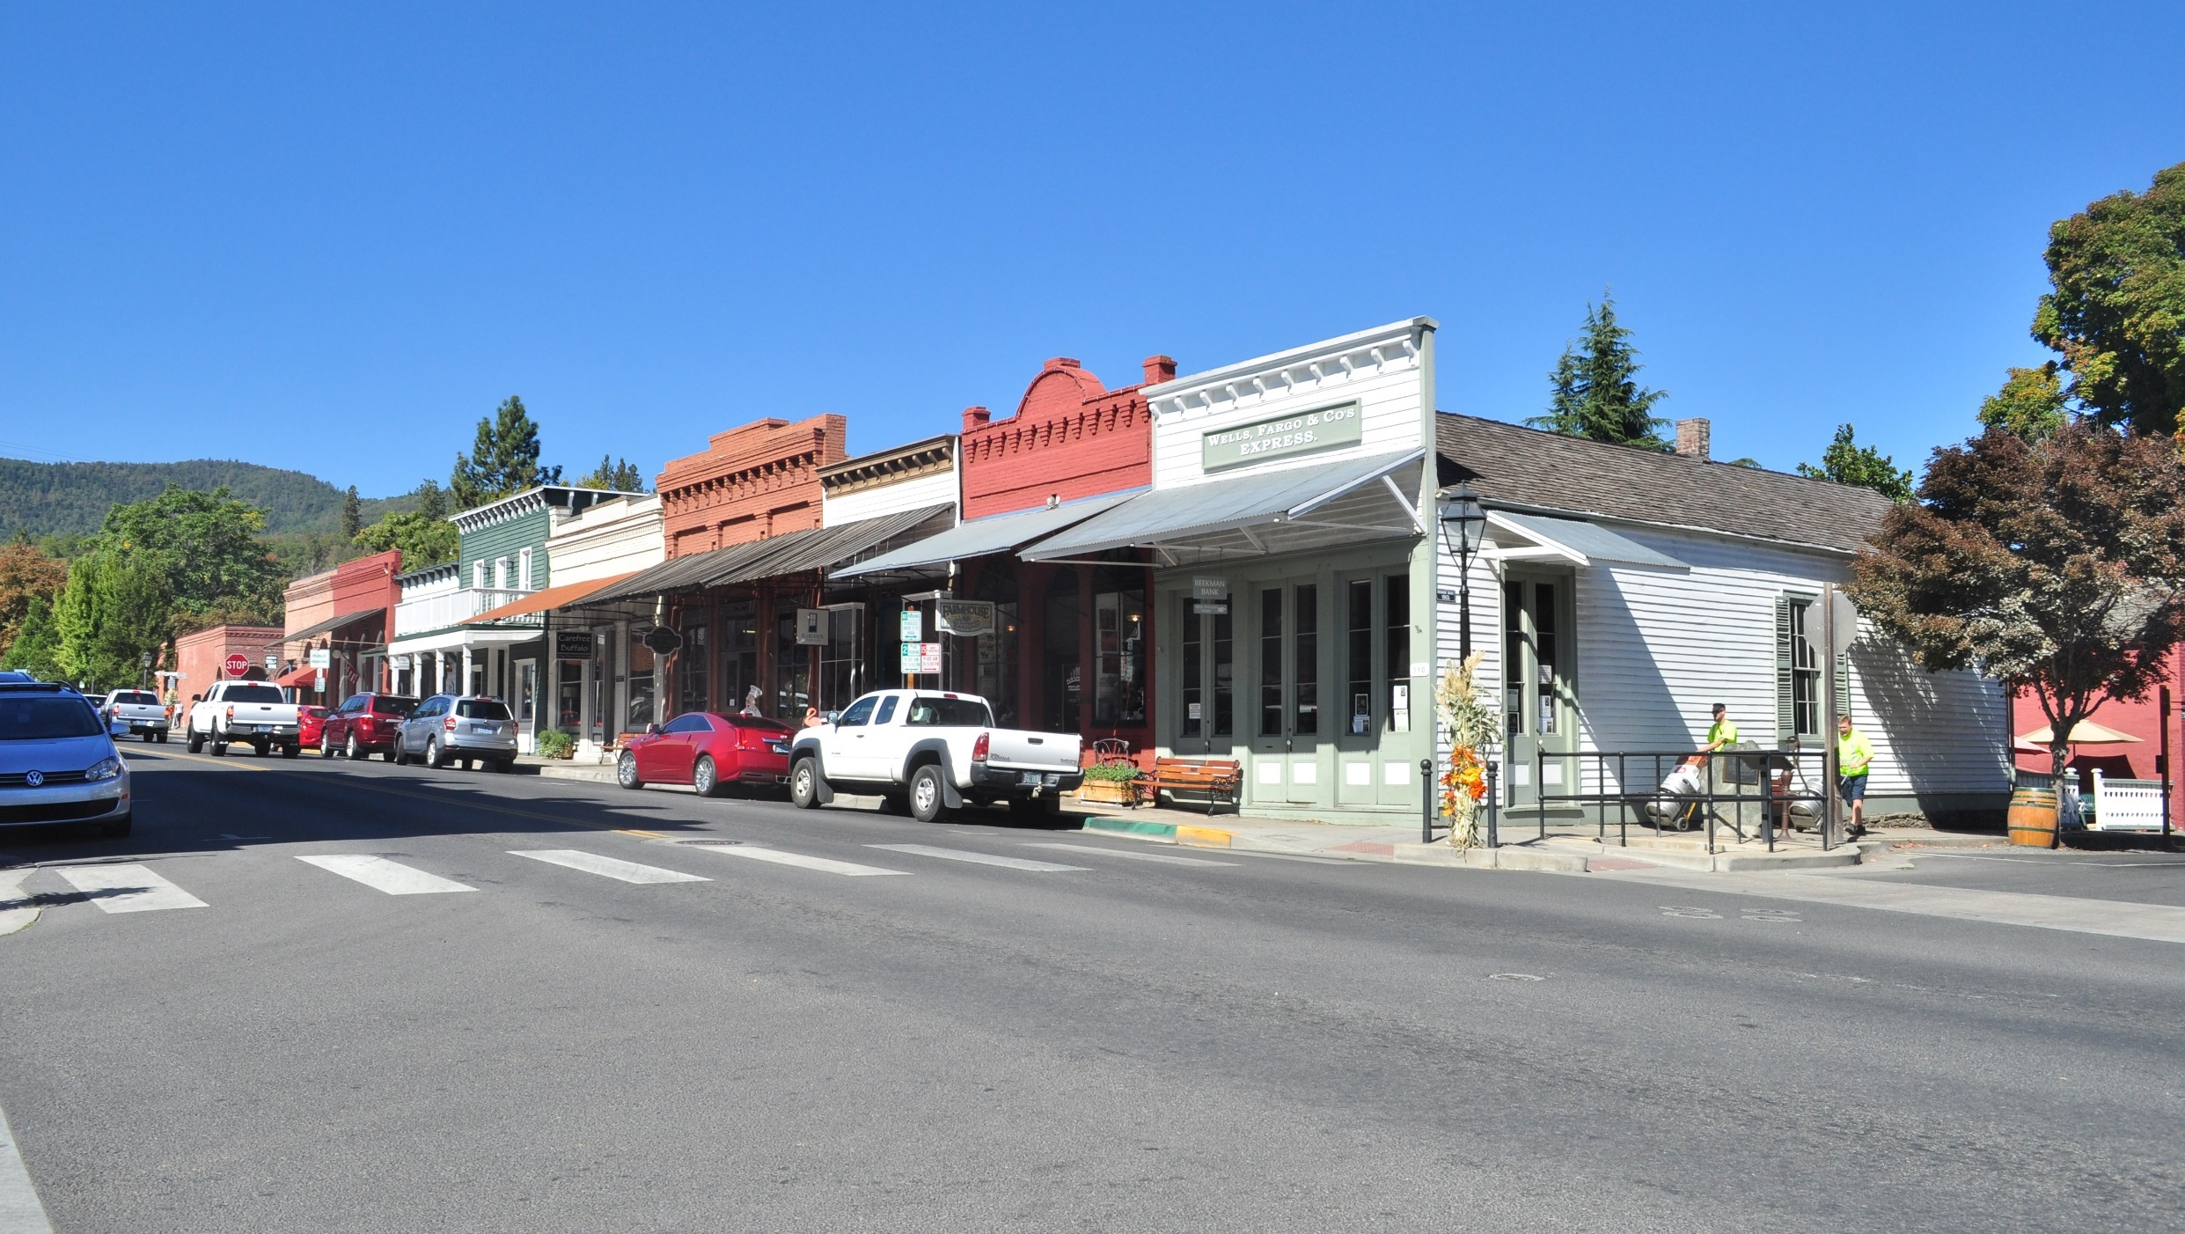
Oregon Heritage Districts
Beekman Bank and other wooden buildings on West California Street in downtown Jacksonville, OR. Historic Jacksonville, Inc., which operates tours of Beekman Bank, was part of the proposed Rogue Valley Heritage District which was defeated in a November 2016 ballot. Photo by Joe Mabel, via Wikimedia.
https://upload.wikimedia.org/wikipedia/commons/d/d5/Jacksonville%2C_Oregon_-_Beekman_Bank_and_other_California_Street_buildings.jpg
Notes:
To be approved:
Must elect a board and be discussed at a public hearing (in each county, if applicable)
Board must be composed of 5 members, elected by electors of the district by either election at large or by zone.
The board must include a representative of the museums.
Any elector residing within the district is qualified to serve as a board member.
The enabling legislation authorize the heritage board to assess, levy, and collect taxes to the costs
The board must determine and fix the amount of money to be levied and raised by taxation each year.
It does not appear to have been utilized often) Oregon’s Jackson County Board of Commissioners placed a proposal for a heritage district on Nov 2016 ballot. It failed.

Slide 13
4. Property Tax Freezes & Local Property Tax Surcharge
Massachusetts Community Preservation Act Local Property Tax Surcharge
Illinois Property Tax Freeze for Residential Properties
Class L Property Tax Incentive, Cook County IL
Notes:
local property tax freeze programs to encourage rehabilitation of historic structures.

Slide 14
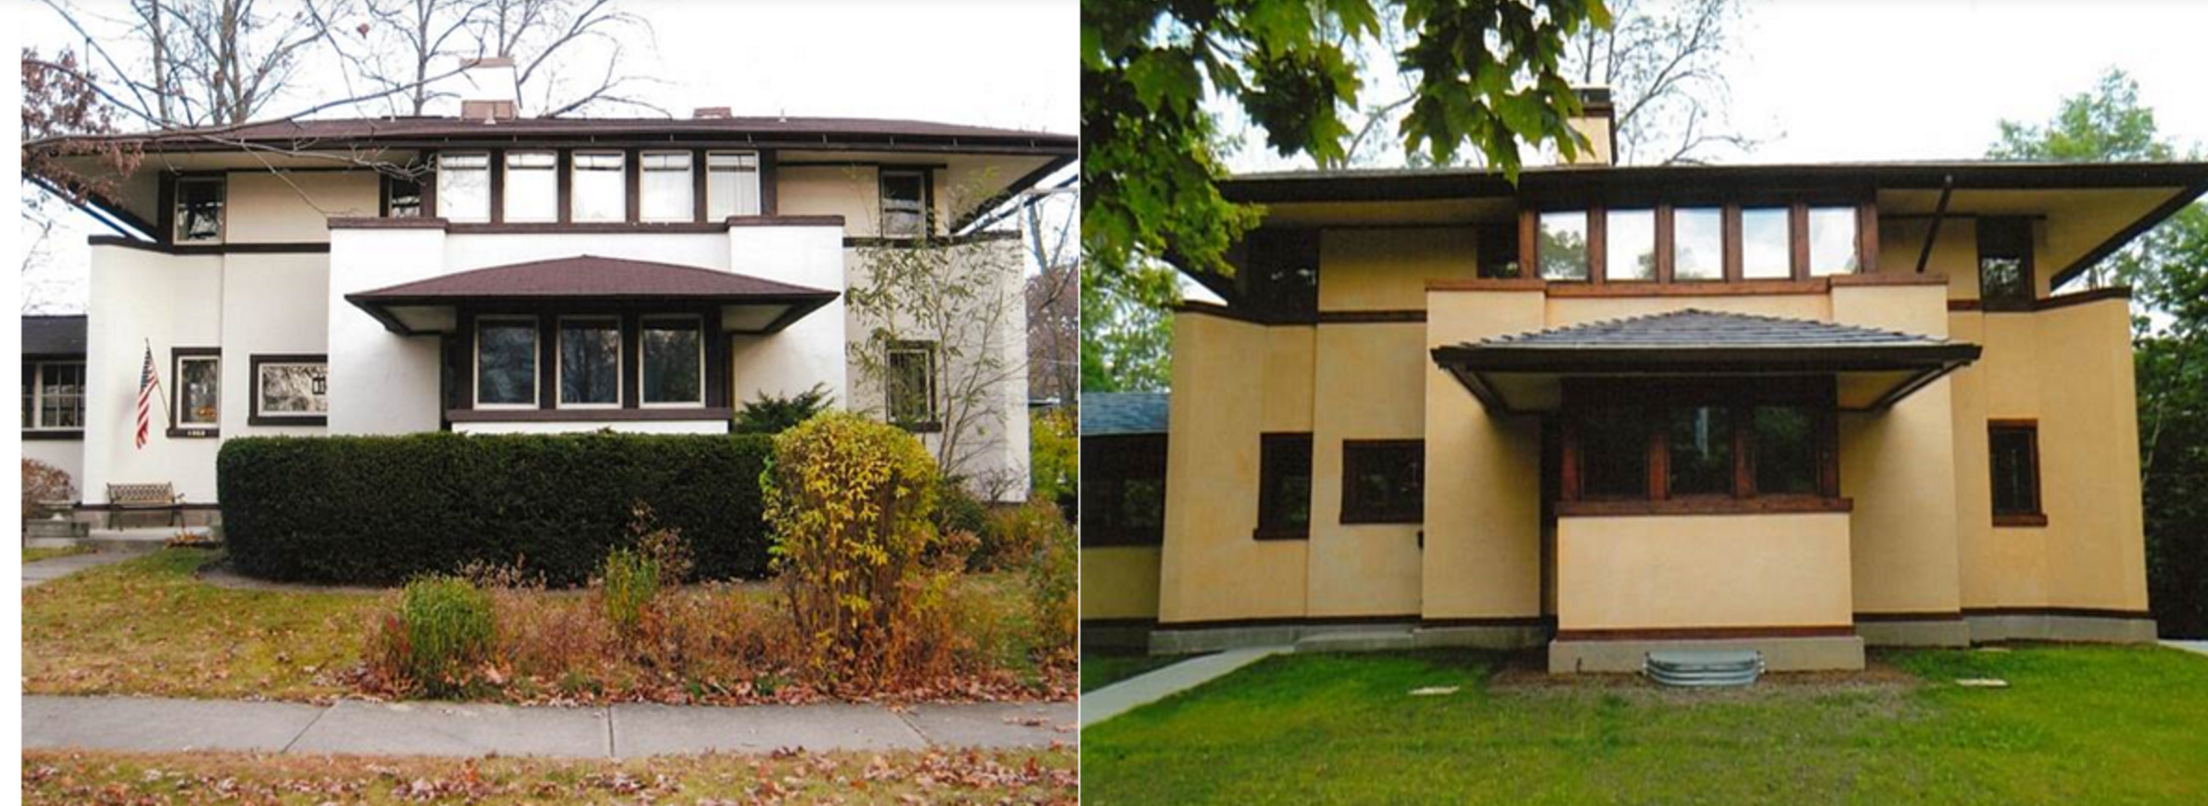
Illinois Residential Property Tax Freeze
Frank Lloyd Wright designed the Mary Adams House in Highland Park, which used the Property Tax Freeze Program in Illinois.
Source Landmarks Illinois. http://www.landmarks.org/resources/preservation-news/property-tax-assessment-freeze-program-now-available-historic-homes-district-113/
Notes:
The Illinois Property Tax Freeze program encourages rehabilitation of residential landmark properties by fixing the property taxes to pre-rehabilitation rates for up to 12 years.
The Illinois PTAFP freezes the assessed value of a historic owner-occupied, principal residence for 8 years while the owner undertakes a substantial, approved rehabilitation project.
Eligible structures are undergoing rehabilitation with a budget that exceeds 25% of the property’s assessor’s fair market value within a 24-month period.
Obligations
Exterior front and usually the side must be retained. Encourage adding weather-stripping and storm windows. The house’s main room must be retained
• “Do it yourself” labor can qualify for the rehab budget. Applicants must submit a “Do-It-Yourself Labor Report.” Plumber can qualify for his normal billing rate for plumbing but not sheet rocking, that would be minimum wage.

Slide 15
5. Gaming Revenues
Colorado State Historical Fund Program Matching Grants
Notes:
Colorado State Historical Fund Program Matching Grants for Preservation Projects has existed since 1990 and has funded more than $273 million in grants from gaming revenue. A very wide variety of projects including archeology is supported with these grant funds.

Slide 16
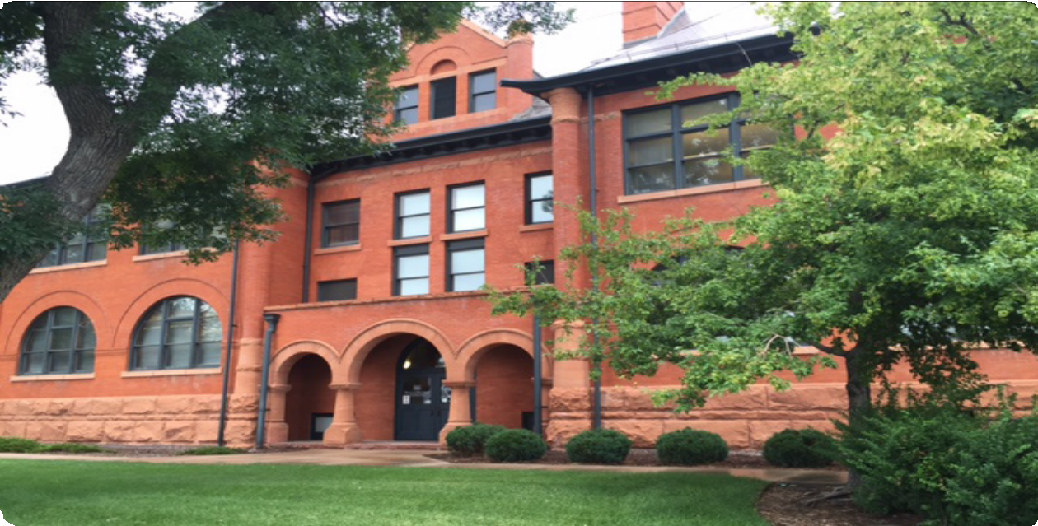
Colorado State Historical Fund
The Colorado Springs Housing Authority received a $625,000 grant from the Colorado State Historical Fund, supported by gambling proceeds, to rehabilitate the historically-designated Lowell School into their office space. Photo: http://www.quantumcommercial.com/historic-lowell-school-listing_detail-394.aspx
Notes:
The Colorado State Historical Fund is supported by gambling revenue.
The grant program has helped to create jobs, restore structures for reuse as businesses and affordable housing, and boost tourism all while preserving Colorado’s history for future generations.
The State Historical Fund is bolstered by 28% of the total tax revenue created by gambling.
Grant amounts are based on project needs. The largest grant, which amounted to $625,000, was issued to the Colorado Springs Housing Authority for their adaptive use of the Lowell School into their office space. Most grants are less than $200,000.

Slide 17
6. Direct Funding from State Governments
Minnesota Historical Society Grant Programs
Notes:
The highly-regarded Minnesota Historical Society offers Minnesota Historical and Cultural Heritage Grants that support history collections, care and management, reproduction, interpretive programs and public education, museum and archives environments, oral history, research and writing, and publications.

Slide 18
7. Direct Funding from Statewide Nonprofit Organizations
Illinois Landmarks Illinois Preservation Heritage Fund Grant Program
Notes:
Landmarks Illinois is a statewide preservation organization. Since 2004, they have offered small matching grants (under $2500) from their annual operating budget through their Preservation Heritage Fund Grant Program.
These grants fund preservation efforts for historically, culturally, or architecturally significant structures across the state.
• Grants are very small. They range from $500-$2,500 to fund preservation efforts for historically, culturally, or architecturally significant structures in the state.

Slide 19
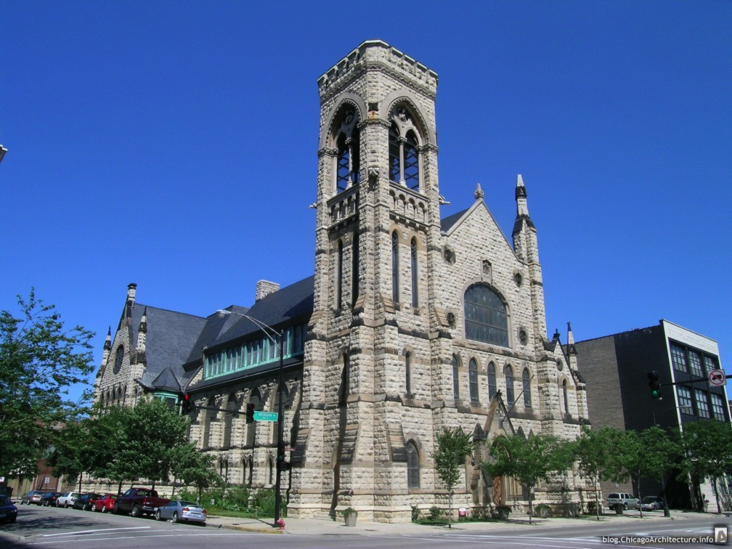
Landmarks Illinois Preservation Heritage Fund Grant Program
Second Presbyterian Church in Chicago was a recipient of the Landmarks Illinois Preservation Heritage Fund Grant.
http://www.2ndpresbyterianfriends.org/preservation/previous-projects
Photo by Martin Cheung, http://www.chicagoarchitecture.org/2013/06/13/the-south-loops-revival-brings-new-appreciation-for-chicagos-landmark-second-presbyterian-church/second-exterior-modern/
Notes:
Established in 2004, the fund is allocated from Landmarks Illinois’ budget annually and offers financial aid to significant sites in Illinois that are in danger of being demolished, are deteriorating, need to be structurally stabilized, or have re-use potential.
… can also fund studies that determine whether sites should be designated as landmarks.
Grants are very small they range $500-$2,500 to fund preservation efforts for historically, culturally, or architecturally significant structures in the state.
Eligibility:
Applicants must be a nonprofit or governmental organization that owns the structure in question.
Exceptions: if the only way to preserve the eligible structure is through issuing the grant, and if the public good achieved by preserving the site is greater than the benefits to the applicant.
The grant must be used for projects that are related to the preservation efforts of an eligible structure, not for expenses related to regular maintenance or ownership

Slide 20
8. Loan Funds
Maryland Heritage Area Authority Loan Program
Maryland Historic Preservation Loan Fund for Capital Projects
Notes:
Maryland and several other states and municipalities have loan funds for preservation projects.
Loans are offered to local jurisdictions, nonprofit organizations, business entities, and individuals that assist and encourage efforts to acquire and preserve historic properties.

Slide 21
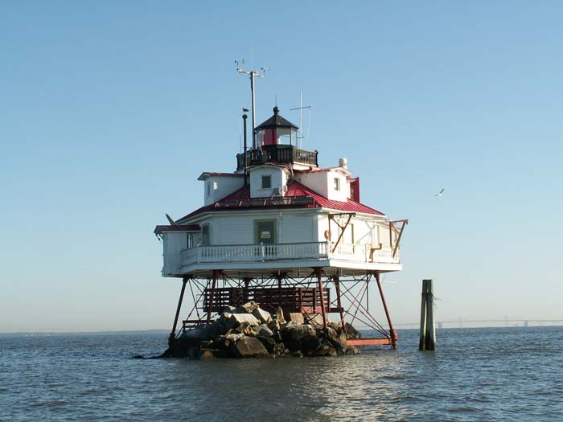
Maryland Heritage Area Authority Loan Program
Maryland Heritage Areas connect people, water, and land to tell a unique story about Maryland’s history. https://mht.maryland.gov/heritageareas.shtml
Notes:
The Maryland Heritage Area Authority Loan Program
…offers loans to nonprofit organizations, local jurisdictions, individuals, and businesses located within the 13 state designated heritage areas to further preserve the area’s history, enhance heritage attractions, or support visitor services.
The Maryland Heritage Areas Authority is operated by the Maryland Historical Trust, which acts as the SHPO, and oversees the Maryland Heritage Areas Loan Program. The authority offers loans to nonprofit organizations, local jurisdictions, individuals, and business located within heritage areas.
Loans are issued on a first come, first served basis for all projects. Their interest rates vary.
Maryland Heritage Areas can use the loans for a wide variety of purposes.

Slide 22
9. Endowments
New Jersey Cultural Trust Matching Grants for Endowments
Notes:
Programs that incentivized the creation or expansion of permanent endowments for historic organizations, especially local preservation organizations, historic sites, or house museums.

Slide 23
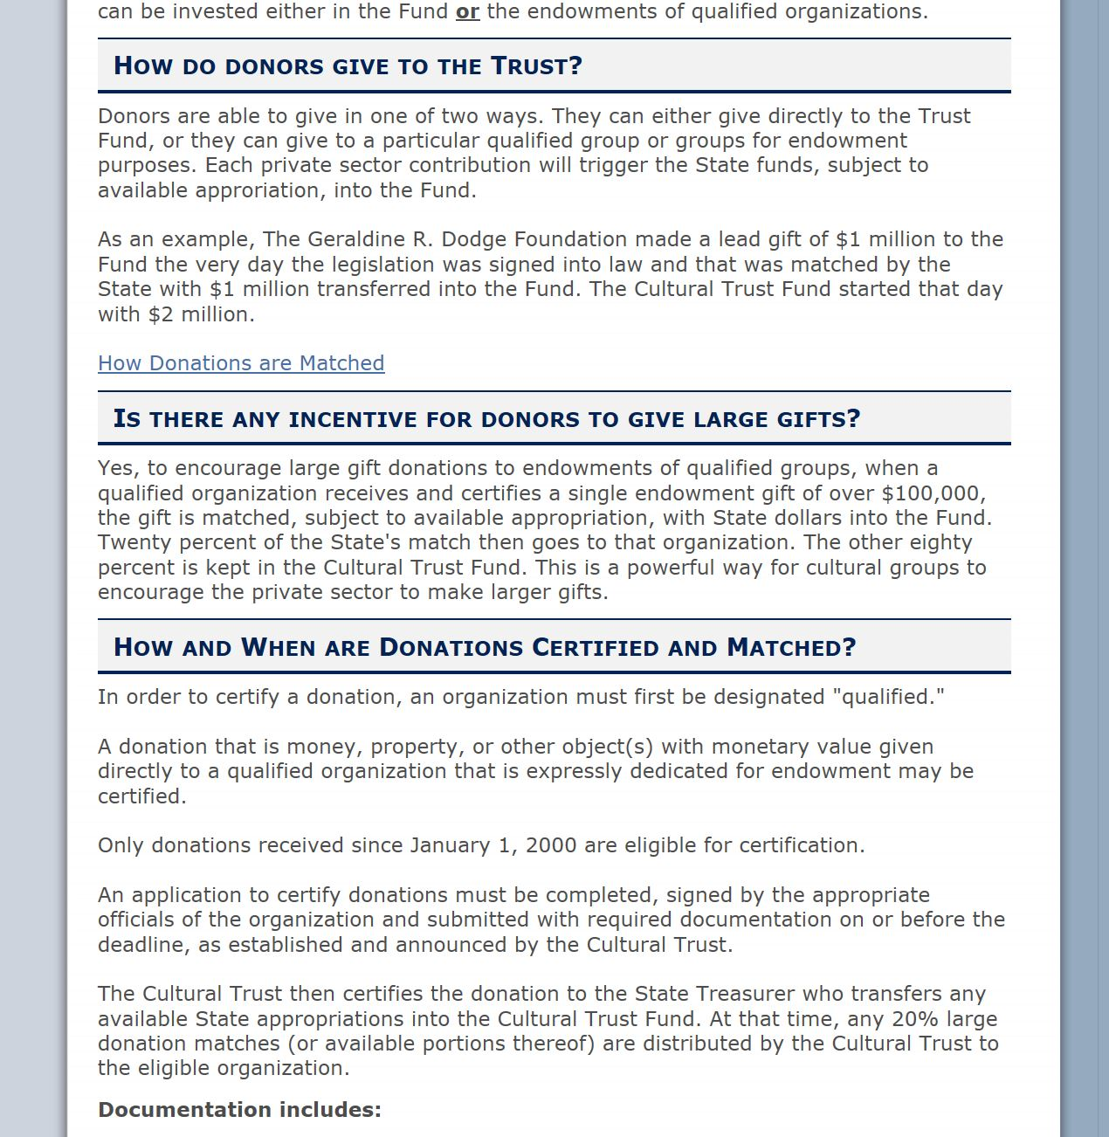
New Jersey Cultural Trust Matching Endowment Funds for History Organizations
Website of the New Jersey Cultural Trust describing endowment matching program.
http://www.nj.gov/state/culturaltrust/dos_ct_information.html
Notes:
The New Jersey Cultural Trust offers matching grants to history organizations that receive large gifts ($100,000 or more) for their endowments.
The NJCT is a public-private initiative that has been trying to:
]
• Develop at least $200,000,000 through equal contributions from state and outside sources that can be invested either in the FUND or the endowments of qualified organizations.
• … encourages large gift donations to endowments of qualified groups.
• Qualification (an organization):
• Private, nonprofit, tax-exempt, arts, humanities, or history organization incorporated in New Jersey and operating for at least 4 years.
• Private donors have the option to make a "restricted donation" directly to qualified organizations for endowment, which are matched by the Cultural Trust once certified.

Slide 24
10. Other Incentives or Funding for Heritage Projects
Oregon Cultural Trust Grant Programs
Bergen County New Jersey Heritage Trust Fund
Snohomish County WA Community Heritage Grants
Maryland Traditions Grants
Vermont Downtown and Village Center Sales Tax Reallocation Program
Cook County Illinois Permit Fee Waiver Program
Notes:
We identified these six programs in our research as being interesting, out of the ordinary or typical of their type.

Slide 25
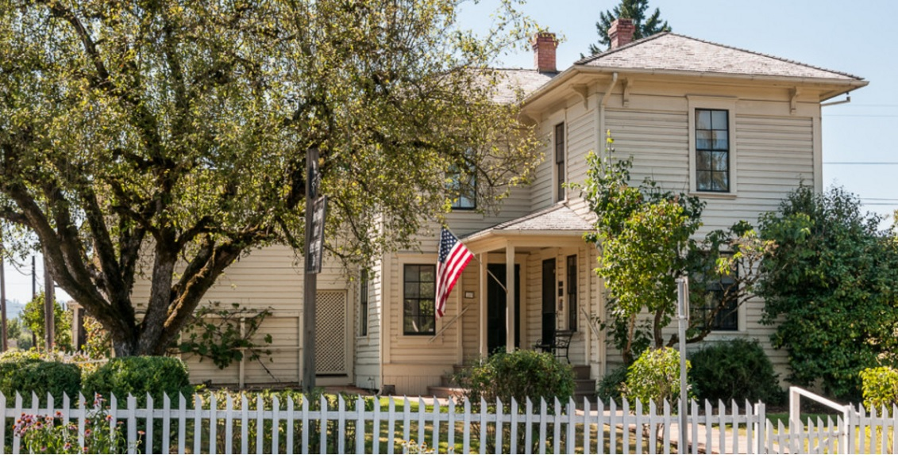
Oregon Cultural Trust Matching Grant Programs
The National Society of the Colonial Dames in Oregon was awarded a $40,000 grant to support the structural stabilization of the Hoover-Minthorn House Museum in Newberg, Oregon in 2016. Photo source: http://www.hooverminthorn.org/
Notes:
Created in 2002 by the Oregon Legislature, the Oregon Cultural Trust is funded through donations made by members of the public in exchange for a 100% state income tax credit for their charitable giving to the Trust.
The Trust raises more than $4.5 million annually, 40% of which goes back into the permanent fund to foster continued growth.
The remaining 60% raised, plus investment income from the permanent fund, is distributed through three annual grant programs-- Cultural Development grants, Cultural Coalition grants, and Cultural Partner grants.
In fiscal year 2016-17, the Cultural Trust will award 149 grants totaling $2.9 million to cultural nonprofits.
Every Trust donor gives first to any of Oregon’s 1,400 participating cultural nonprofits, then matches that gift with a contribution to the Trust. There are 326 organizations on the heritage nonprofits list, including some Main Street programs. Cultural Development grants are awarded in four categories and are intended to fund arts, heritage, history, preservation, and humanities projects. Grants generally range from $5,000 to $40,000 with a maximum request amount of $50,000, and a one to one match is required.

Slide 26
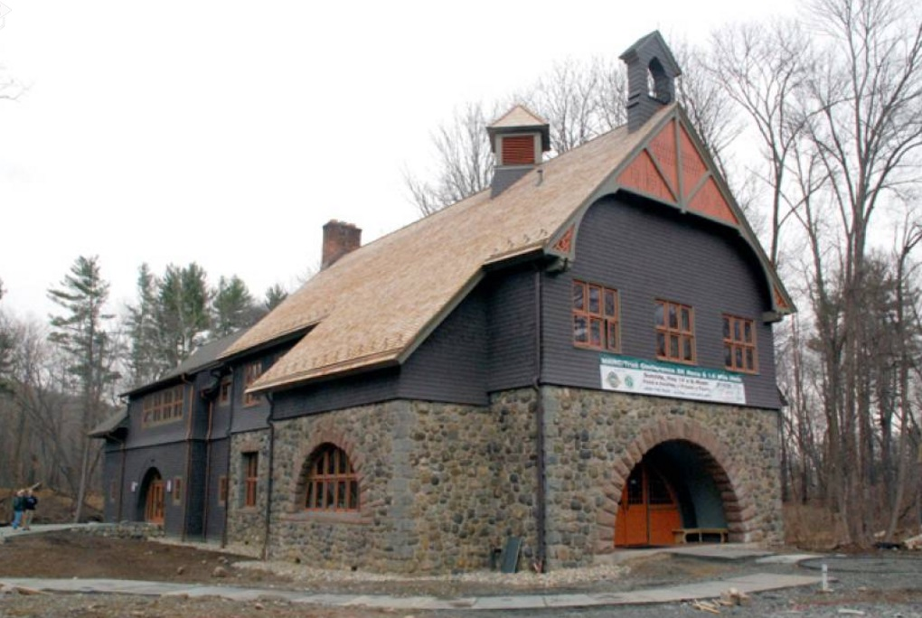
Bergen County, NJ County Bonds For Open Space And Historic Preservation
The 11-year restoration and reuse of the 1891 Darlington Schoolhouse in Mahwah, NJ was supported with funds from the Bergen County Open Space and Historic Preservation Trust Fund. Photo source: NorthJersey.com More information: https://www.nynjtc.org/content/darlington-schoolhouse
Notes:
Established in 1998, Bergen County, New Jersey’s Trust Fund program supports open space, recreation, floodplain protection, farmland and historic preservation projects. Bergen County’s Trust Fund is one of 19 (of 21) counties in New Jersey that have used bond funds to pay for open space, farmland, and historic preservation purposes.
The Trust Fund is funded through a property tax assessment determined annually by the governing board of the county, at a rate not to exceed .01% of the total county equalized real property valuation. The Trust Fund is divided into two separate programs: the County Program, which receives 70% of the money, and the Municipal Park Improvement Program, which receives the remaining 30%.
Historic preservation funding falls under the County Program. Trust Fund dollars are used countywide to preserve land, maximize recreational opportunities, acquire flood-prone properties, and preserve farmland and historic buildings.
http://www.anjec.org/pdfs/PublicFinancingOpenSpace.pdf
http://www.co.bergen.nj.us/index.aspx?NID=203

Slide 27
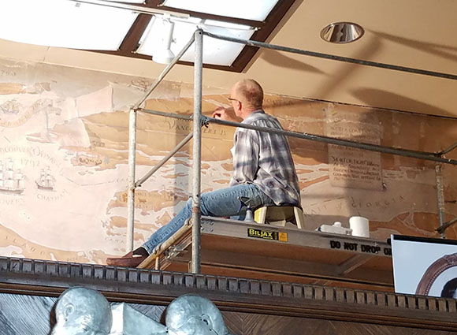
Snohomish County, WA Community Heritage Grant Program
The Everett Library mural preservation was funded by Snohomish County’s Community Heritage Grant Program. http://www.preservewa.org/News178.aspx
Notes:
The Historic Preservation Commission of Washington’s Snohomish County operates a grant program to bolster the county’s heritage. The Community Heritage Program offers matching grants to public and non-profit organizations to support Snohomish County’s historic preservation projects. The matching grants can be issued in amounts up to $10,000. The grant program is funded with an allocated amount of the document recording fees collected by the Snohomish County Auditor. According to legislation, a portion of these fees are to be used for projects that promote historic preservation and programming. http://www.preservewa.org/News178.aspx https://app.leg.wa.gov/rcw/default.aspx?cite=36.22.170

Slide 28
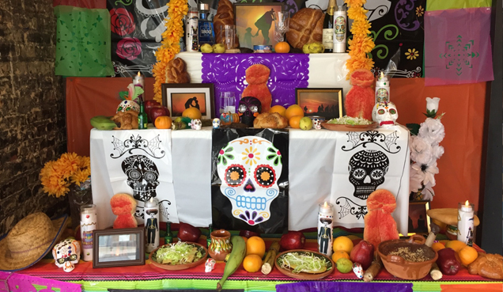
Maryland Traditions Project Grants
Dia de los Muertos Traditions, produced by Creative Alliance and Artesanas Mexicanas, received an award of $5,000 from the Maryland Tradition Project Grants for 2017. The program honors Day of the Dead beliefs and its folkloric art forms. http://www.creativealliance.org/events/2016/community-altars-dia-de-los-muertos
Notes:
Maryland Traditions Project Grants support nonprofit, tax exempt organizations in their arts programming and projects. Grants are awarded by the Maryland State Arts Council, which is a Maryland state agency run by the Department of Commerce. The awarded amount ranges from $1,000-$5,000. These grants are funded with monies from the State of Maryland, the National Endowment for the Arts, and private sponsors. All grant applications are completed online.
Maryland Traditions was established in 2001 as the statewide folklife infrastructure program of the Maryland State Arts Council (MSAC) with support from the National Endowment for the Arts (NEA) Folk Arts Infrastructure Initiative.
https://www.msac.org/sites/default/files/files/maryland_traditions_FY2018_project_grant_guidelines.pdf

Slide 29
Conclusion
This report is intended to stimulate action
Use all available incentives, create new
Think collectively, work with others in region
Oregon Heritage Commission to identify tools needed and find partners
Oregon Heritage to provide technical assistance to you for county and local efforts
Notes:
We are at the end of our time together.
I wanted to share with you the conclusions that the Oregon Heritage staff has as a result of this research.
This report is intended to stimulate action.
As a group of heritage proponents, we must use the tools available now and develop additional tools in order to strengthen financial support for heritage efforts regionally and statewide. We need to think beyond our individual organizations, for the benefit of our organizations as well as others. Through this report and the results of the Oregon Heritage Summit, Oregon Heritage is committed to providing technical assistance to such efforts.
The Oregon Heritage Commission will take input from the Oregon Heritage Summit to understand what tools are needed to forward the effort to fund heritage. They will work to find partners and resources to develop those tools. Together we can strive to rally heritage activists across the state to better support Oregon heritage efforts.

Slide 30
What you can do tomorrow
Contact City Council and State Reps to discuss your organization’s work
Invite elected officials to your next event
Hold a regional heritage organizations about new incentives to pursue
Support Oregon Cultural Trust
List your organization as partner
Promote tax credit locally
Send thank you letters to those that donate to tax credit program
Promote any existing county incentive program
Make county officials aware of your organization
Make sure heritage is part of tourism funding
Notes:
Have a board member, member, or visitor give a letter, email, or call to your city council members or state representatives about how important the work you do is.
For your next event, invite all of your local elected officials.
For your next grant award or completed project send a press release our about it to everyone, especially elected officials.
Schedule a brown bag lunch or coffee meeting with other heritage organizations in your area and talk about options to initiate or support.
Support Oregon Cultural Trust. List your organization as partner. Promote tax credit locally. Send thank you letters to those that donate to tax credit program.
Promote any existing county incentive program. Make county officials aware of your organization. Make sure heritage is part of tourism funding.

Slide 31
THANK YOU!
Donna Ann Harris
422 South Camac Street
Philadelphia PA 19147
267 251 5444
donna@heritageconsultinginc.com
Notes:
I truly enjoyed doing this research for Oregon Heritage. I think it has national importance.
I hope that learning about some of these incentives being used around the country will encourage you to learn more about them and begin to advocate for them at the local, county, and state levels.
Here is my email and phone. Please contact me with your questions.
Thank you

