Slide 1
Main Street/Elm Street Boards & Fundraising
Use THIS 20 slide presentation with YOUR Board of Directors!

Slide 2
Fundraising and MS/ES Boards
Main Street/Elm Street boards are a combination of working boards and governing boards
As MS/ES organizations mature and take on larger projects, board membership needs to change
Training is needed so board members understand their roles as fundraisers

Slide 3
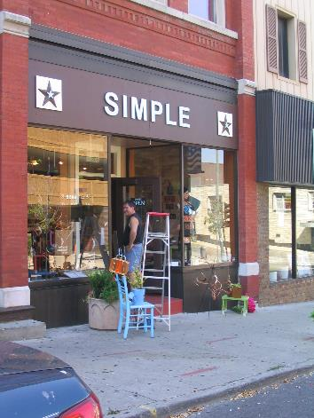
Traditional expectations of Board members
Board is responsible for a well funded organization
“Give, get or get off”
Time, talent, treasure
Board giving requirements
Recommend a Board Commitment Form BEFORE they are nominated
Notes:
Board term limits might be a gift

Slide 4
Typical MS Board fund raising activities
Make your own gift first
Recruit new annual gifts
Recruit people to fundraising events
Be responsible for oversight of the whole of fundraising and budgeting process
Review all fundraising materials, fundraising plan, and participate in solicitations

Slide 5
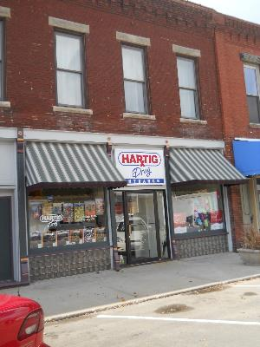
Current Board fundraising expectations
Clear Board fundraising expectations are best
Make their own “stretch” gift
Attending all of your ticketed events
Ask others to attend
Soliciting other annual gifts
Soliciting other major gifts

Slide 6
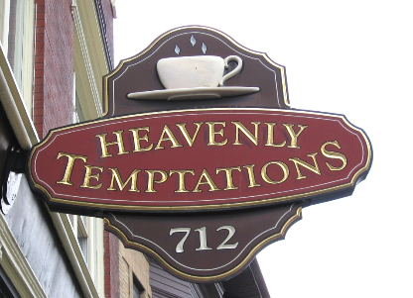
Evolving your board membership
Evolve from being solely worker bees to identifying a handful of Board members with wealth or access to wealth if major gifts are contemplated
But every board member can do something to help with fundraising

Slide 7
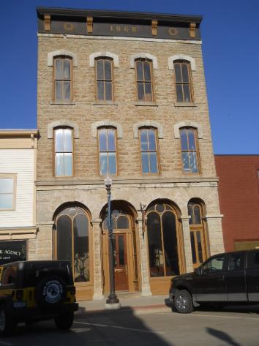
“Friendraising” not fundraising
Cultivation of potential prospects
Everyone can do their part in friendraising
All can be ambassadors for the organization no matter their own giving level

Slide 8
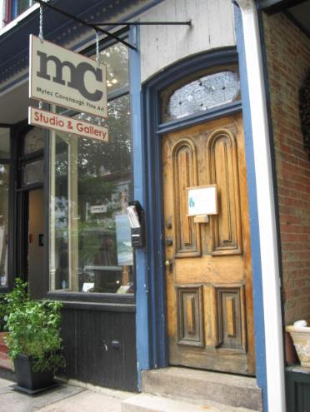
Recruitment of friendraisers
3 Levels of involvement in fundraising
Laying the foundation
Friendraising
Solicitation of in-kind and cash gifts

Slide 9
1. Laying the foundation: Board Member tasks
Understand mission/vision
Give your own gift
Learn about strategic direction of organization
Review fundraising/development plan
Participate in Team/Committee activities
Become an ambassador for the organization
Speak out positively in public and private about the organization

Slide 10
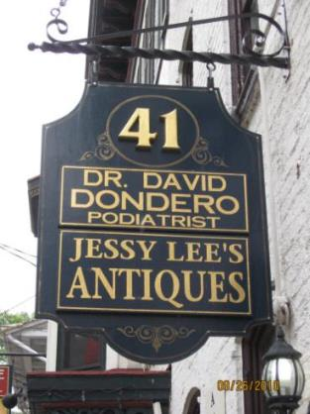
2. Friendraising: Board Member tasks
Provide names of friends as potential prospects for annual gifts
Bring the mailing list up to date
Participate in any fundraising training
Make speeches on behalf of the organization
Solicit volunteers at event tables

Slide 11
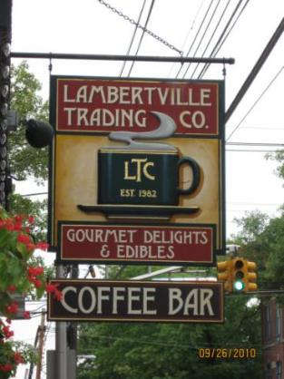
2. Friendraising: Board member tasks
Identify stories of how MS has helped the community
Write newsletter stories
Call new members to thank them for joining
Identify potential donors
Identify foundations, corporations, government agencies for funding opportunities

Slide 12
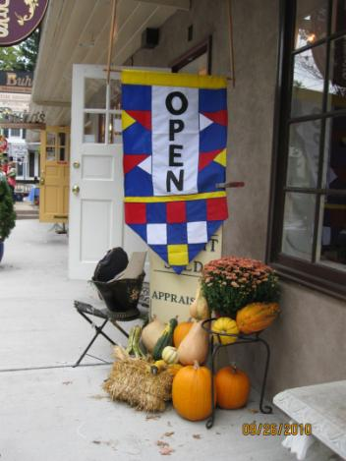
2. Friendraising: Board member tasks
Participate in fundraising events as a volunteer
Send handwritten thank you notes to donors
Visit with an elected official to talk about your program
Host a party in your home as a cultivation event

Slide 13
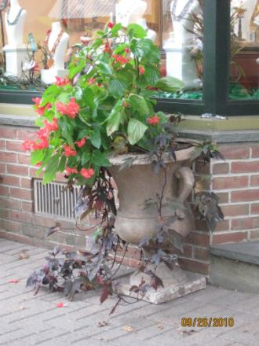
3. Solicitation
Sign letters with notes to potential members
Ask for sponsorships from businesses you know
Seek in-kind donations from businesses you know
Call people to renew their memberships

Slide 14
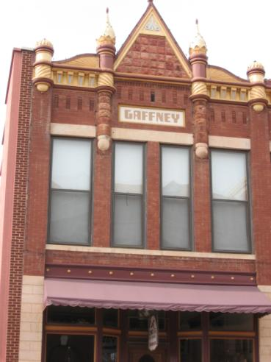
3. Solicitation: Board Member tasks
Send emails to donors to remind them of events
Increase your own gift
Cultivate potential donors
Ask people to pledge to the organization
Participate in The Ask for major gifts

Slide 15
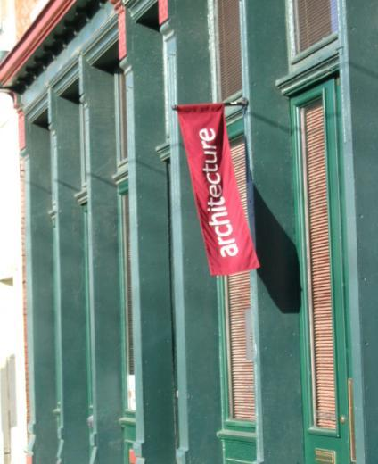
Every Board member can do something!
This methodology removes most of the fear from individual board members
Board members see where they fit in the whole friendraising process
Everyone can do something to help
Will be more likely to be willing to help

Slide 16
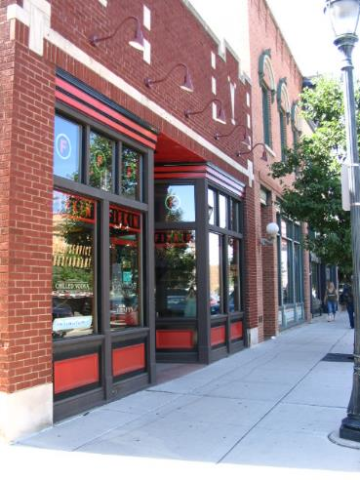
Thinking about YOUR board
Who do you have now?
Types of fundraisers
Foundation layers
Solicitors
Friendraisers
How many of each do you have NOW?
What if there are NO solicitors? FIND SOME FAST

Slide 17
Take Home Exercise
Review the sheet with typical board activities for fundraising/friendraising
Board members check yes/no/maybe for each item
Please limit maybes to only 5
Be prepared to discuss some of your “Yes” answers

Slide 18
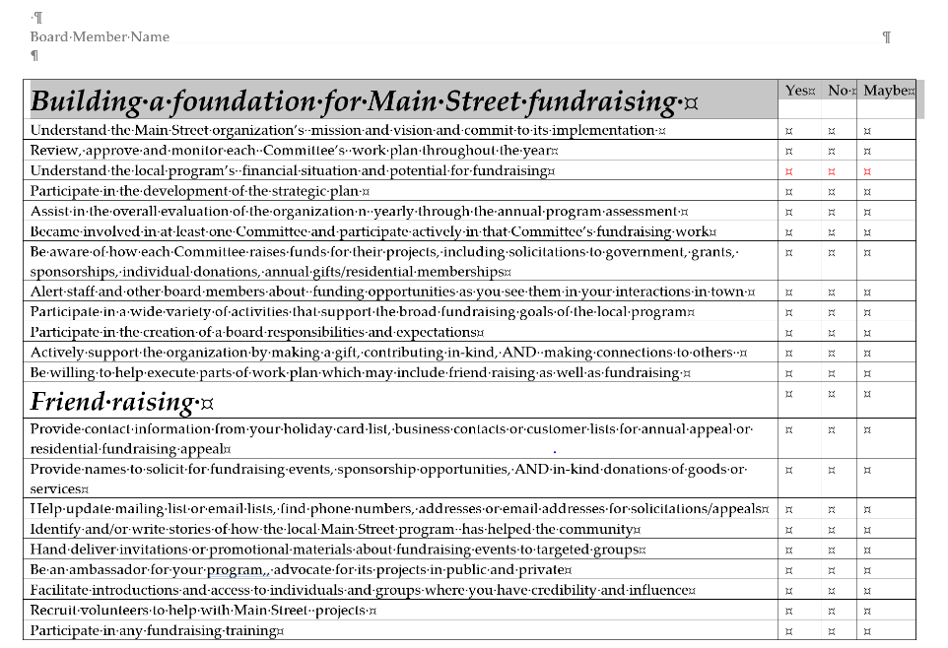

Slide 19
End of your board presentation

